Slide 1
Lecture #: 04
Lecture Date: 06/03/2013
Course: Theory of Computer Science
Topic: Finite Automata

Slide 2
Background
Why need formal definitions of language
      Define a precise, unambiguous and uniform interpretation
      Communication with machines
Formal Language notation/definition
      Regular Expression
            Tell how to generate words of that language
            Tell which words belong to this language
            Can this be automated

Slide 3
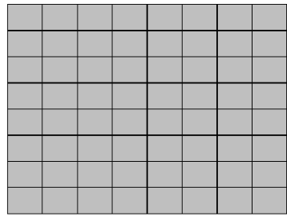
Introduction to Finite Automata
Consider the following game board that consists of 64 boxes

Slide 4
Continue…
  We are supposing that there are some pieces of
  paper. Some are of white colour while others
  are of black colour.
  The number of pieces of papers are 64 or less.
  The possible arrangements under which these
  pieces of paper can be placed are finite.
      – Because number of boxes are finite, number of pieces are finite. If we will keep placing the arrangements then there will be one stage where the previous stage will be repeated.

Slide 5
Continue…
  There are pair of dice that can generate the numbers 2,3,4…..12
  To start the game, one of the arrangements is supposed to be initial arrangement.
  For each number generated, a unique arrangement is associated among the possible arrangements.
      – Means if we are at certain arrangement and there comes a number then what arrangement should be followed.

Slide 6
Continue…
  It shows that the total number of transition rules
  are finite.
  One and more arrangements can be supposed
  to be the winning arrangement.
  It can be observed that the winning of the game
  depends on the sequence in which the numbers
  are generated.
  This structure of game can be considered to be
  a finite automaton.

Slide 7
Finite Automaton
A finite automaton (FA) is a collection of:
  A finite set of states.
  Exactly one initial state (start state)
  One or more (may be none) final states that mark the acceptance of a word
  Finite set of input letters (∑) from which input strings are formed.
  5. Finite set of transitions i.e. for each state and for each input letter there is a transition showing how to move from one state to another

Slide 8
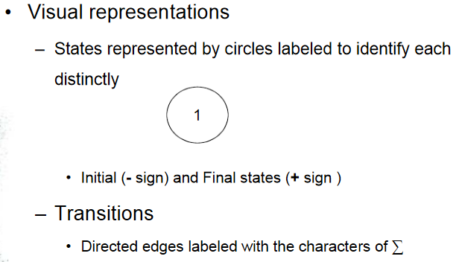
Finite Automaton

Slide 9
Characteristics of FA
  Every FA must have exactly one start state
        There may be multiple or may be no final states
        In the latter case the FA doesn’t accept any language
  Only a single character is read on a state at a time
  Every state defines a transition for every character in the alphabet set or alternatively
  Every state has exactly as many outgoing transitions as the number of characters in ∑

Slide 10
Characteristics of FA
    Each transition labeled with a distinct letter from ∑
      No duplicate edges
      No missing edges
    An FA is built for a particular language and recognizes only that language
    It should accept all valid words of the language
      Not even a single valid word should be rejected.
    It should reject all invalid words of the language
      Not even a single invalid word should be accepted.

Slide 11
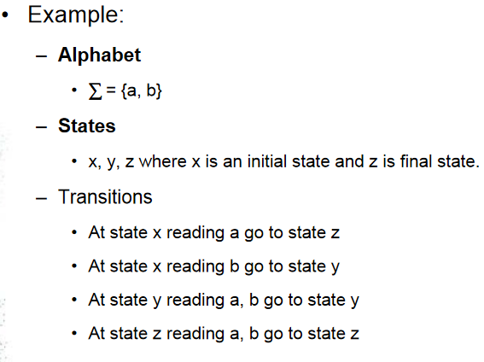
Example:

Slide 12
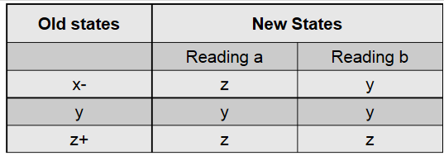
Finite Automaton:Transition Table
These transitions can be expressed by the
following table called Transition Table:

Slide 13
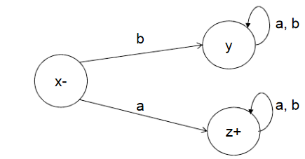
Finite Automaton: Transition Diagram
It may be noted that the information on an FA, given in the previous table, can also be depicted by the following diagram called the Transition Diagram.

Slide 14
Finite Automaton
The previous transition diagram is an FA
accepting the language of strings, defined over ∑={a, b}, starting with a.
Accepting the language – any string which starts from the initial state and ends at the final state while following the path is referred to as accepted string. The collection of all accepted strings will be named with specific language which can be associated with the FA.

Slide 15
Finite Automaton
It may be noted that this language may be
expressed by the regular expression:
      – a (a + b)*
• It may be noted that to indicate the initial state, an arrow head can also be placed before that state and that the final state with double circles.

Slide 16
Finite Automaton
  It is also to be noted that while expressing an FA
  by its transition diagram, the labels of the states are not necessary.

Slide 17
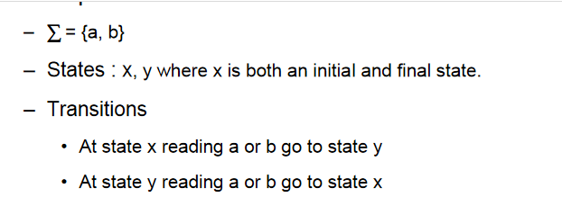
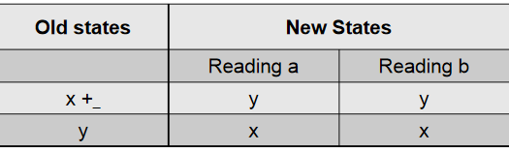
Finite Automaton: EXAMPLE
EXAMPLE
Transition Table:

Slide 18
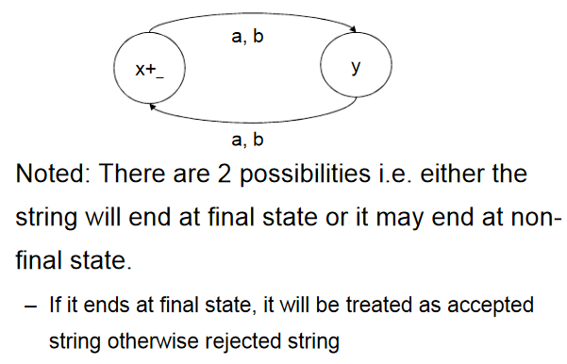
Finite Automaton:Example
Transition Diagram:

Slide 19
Finite Automaton
  What we have discussed is, given an FA can we identify the language accepted that FA.
          • Given a language, can we build FA?
          • Yes/No?
Example:
  Consider the language L of strings, defined over ∑ = {a, b}, starting with b. The language L may be expressed by RE b(a+b)*, may be accepted by the following FA.

Slide 20
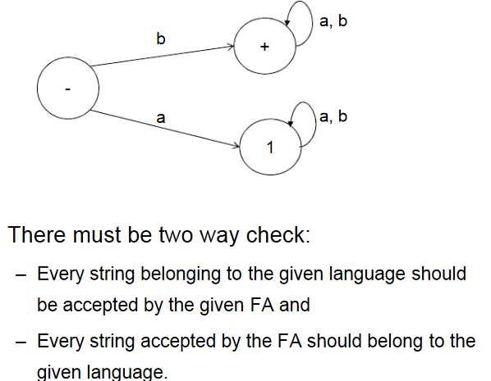
Finite Automaton

Slide 21
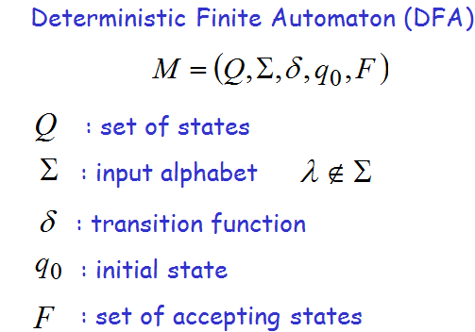
Formal Definition

Slide 22
Set of States
Example

Slide 23
Input Alphabet
:the input alphabet never contains
Example

Slide 24
Initial State
Example

Slide 25
Set of Accepting States
Example

Slide 26
Transition Function
Describes the result of a transition
from state with symbol

Slide 27
Example:

Slide 30
Transition Table for
symbols
states

